Slide 1

ML 101 Course
Arush Garg
AI and Machine Learning Club
Overseas Family School

Slide 2


Course (bit.ly/ML_101)
Introduction to Machine Learning (ML)
Regression
Core ML Concepts
Classification
Decision Trees
Model selection and tuning
Unstructured data: Text
Neural Networks
Unstructured data: Images
Introduction to Deep Learning
Beyond Regression & Classification
Notes:
Welcome back to ML 101 course. In today’s lesson we will learn about the most common type of supervised learning: Classification

Slide 3
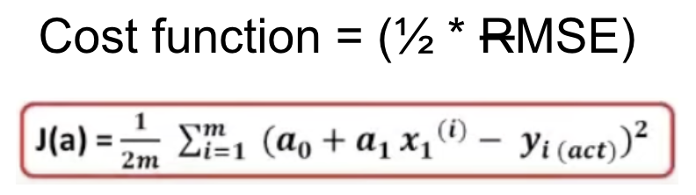
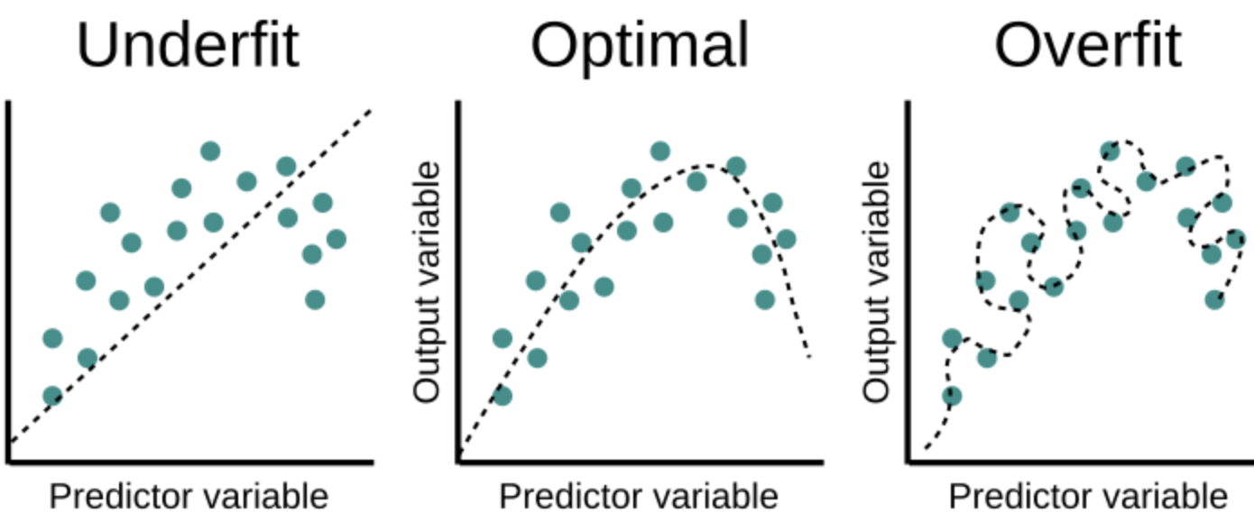
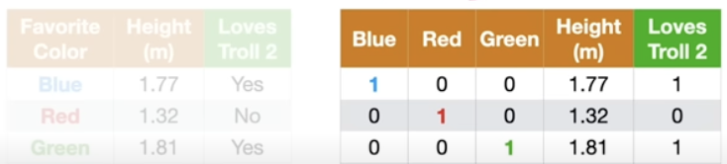
Recap
ML is different from traditional programming
Linear Regression
Type of Supervised Learning algorithm. Predicted value is a “continuous numerical value”
Simple ML model, represented as “wx + b”
Cost function = (½*MSE)
Gradient Descent Algorithm
Under-fitting
Model is not a good fit to training data. Training error is high.
Over-fitting
Model has over-fitted to training data. Training error is very low but test / validation error is high.
Handling non-numerical input features
One-hot encoding for categorical features like “favorite color”. Can increase the number of features significantly.
Notes:
Quick recap first.
We learnt about Linear Regression which is a type of supervised learning algorithm that is used to predict a continuous numerical value. We trained a Linear Regression model to predict GPA.
In today’s lesson, we will cover a completely different type of problem, dealing with categorical labels.
We also covered the core concepts of machine learning: under-fitting, over-fitting and data clearing.

Slide 4
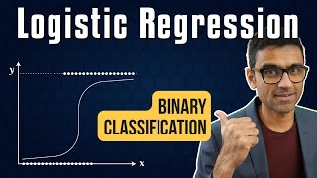
Introduction to Classification & Logistic Regression
Codebasics on YouTube [link]
Notes:
In this video we will introduce “what is classification” and the most common ML algorithm used for classification that is called LogisticRegression (play video)

Slide 5
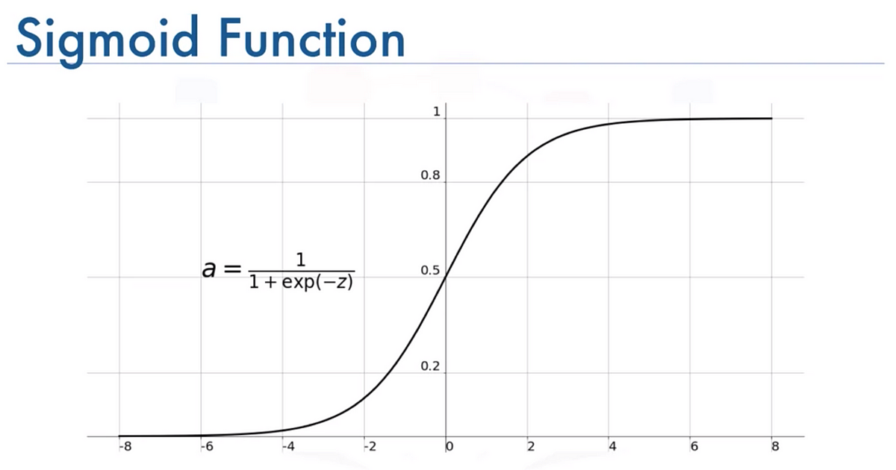
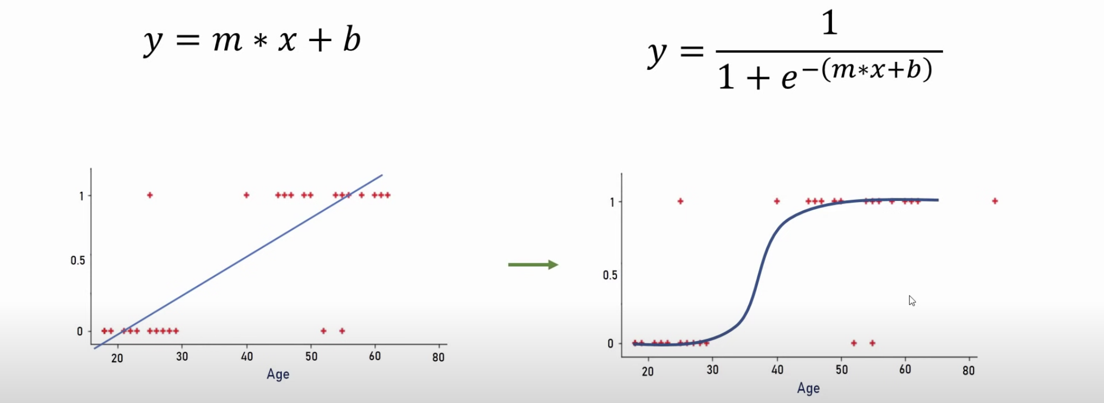
Recap (Classification & Logistic Regression)
Classification = Predict “yes / no” (binary) or “more than 2 choices” (multi-class)
Linear Regression is not a good algorithm to use as a binary classifier
Logistic Regression (“yes/no” classification)
Same equation as linear regression: y = b + w₁x₁ + w₂x₂ + w₃x₃ + … +w_{n}x_{n}
Apply “activation function” (sigmoid) to this linear equation to make it non-linear
Sigmoid outputs value between 0 and 1 which is a probability of “yes”
Using a threshold (e.g. 0.5) we can convert this probability into a classification decision
If probability > 0.5 => “Yes” else “No”
Linear Regression Logistic Regression
YES
NO
In case of Logistic Regression,
z = Linear Regression equation
threshold
Notes:
Recap - when we are making a prediction between two options, we call it a binary classification. More than 2 choices is called multi-class classification.
We apply a “Sigmoid” function to the LinearRegression equation to make it non-linear S-shaped curve which is more suited for Binary Classification as compared to a line
Output of LogisticRegression model is a prob of “yes”. We can convert it into a yes / no decision based on a threshold. E.g. Prob > 0.5 maps to “Yes”, otherwise its a “No”

Slide 6
Using Logistic Regression for Multiclass classification
Assume we want to create a multi-class classifier to predict shape with following possible options:
Class1: Triangle
Class2: Square
Class3: Circle
One vs Rest strategy: We will create 3 different Logistic Regression models (binary classifiers) such that:
Model1: Triangle or Not (Square + Circle)
Model2: Square or Not (Triangle + Circle)
Model3: Circle or Not (Triangle + Square)
Final prediction of the multiclass classifier will be based on the prediction of these 3 models. E.g. if for an input, Model1 predicts 0.7, Model2 predicts 0.3 and Model3 predicts 0.1, we will label it as Triangle (highest probability)
Note: When training a binary (yes / no) classifier, we provide “yes” examples and “no” examples. E.g. for Model1, “yes” examples (also called +ve data) will be data points belonging to Triangle and “no” examples (also called -ve data) will be data points belonging to Square and Circle.
Notes:
Last example clarified how to use LogisticRegression for a binary classification problem.
But how will it work if we have more than 2 classes, e.g. deciding whether an input is a “triangle, square or circle”.
(click)
We solve this problem by mapping it to “multiple binary-classification problems”.
Instead of training one multi-class classifier, we will train multiple binary classifiers, one for each class.
E.g. in this case we will create 3 binary classifiers, one for each shape. And the final prediction will be made based on which binary classifier outputs the highest probability.

Slide 7
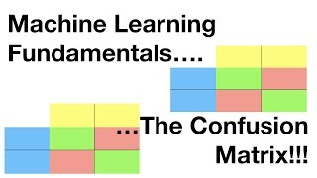
How do we measure the quality of a Classification model?
Udacity on YouTube [link]
Notes:
In case of LinearRegression model we used root mean square error as the measure of model quality.
But the quality metrics for a classification problem are very different. (click)

Slide 8
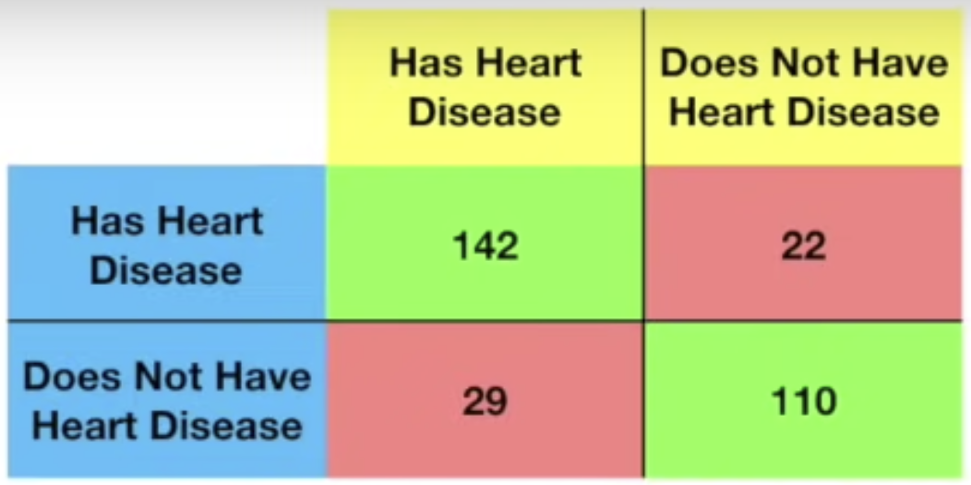
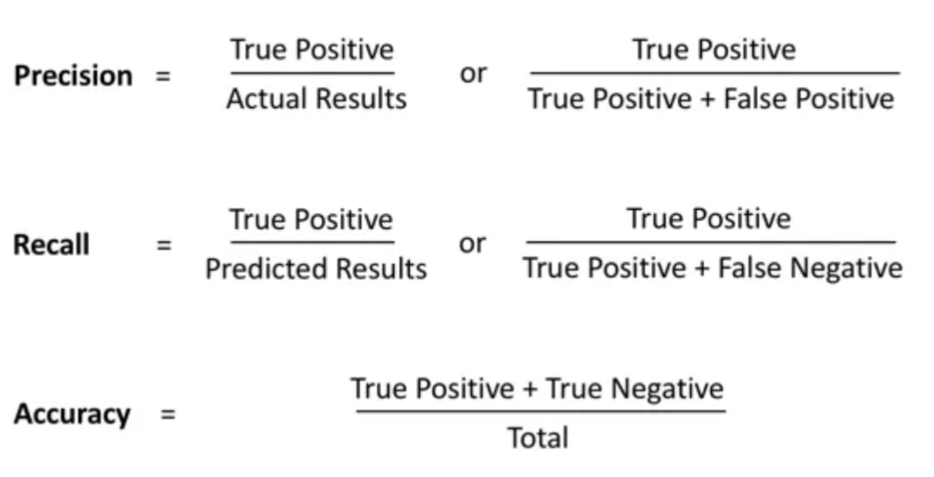
Accuracy, Precision, Recall
— Actual —
— Predicted —
TPs
FPs
FNs
TNs
How often when model predicts “Yes”, it is actually “Yes”
142 / (142 + 22)
Of all actual “Yes” cases, what %age model identified correctly?
142 / (142 + 29)
How often model makes is correct across all predictions
(142 + 110) / (142+22+29+110)
Notes:
Quick overview of the most important classifier metrics
Precision measures: how often when model predicts “Yes”, it is actually “Yes”
Recall measures: of all actual “Yes” cases, what percentage was model able to identify correctly
Note that precision and recall are specific to the class.
And Accuracy measures: of all the “Yes” AND “No” predictions, what percentage are correct

Slide 9
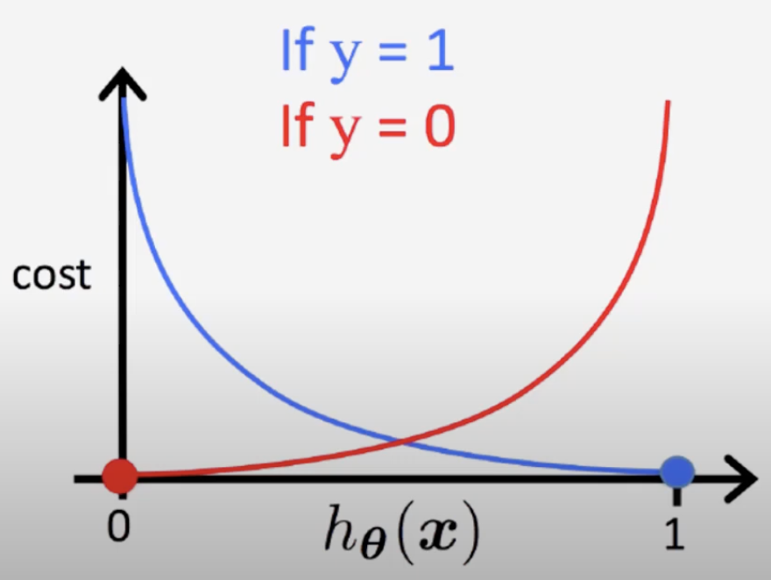
Intuition behind “Logistic Regression” Cost Function
Purpose of Cost Function is to calculate the “error” of the current model and help update parameters (b, w) such that error decreases and model accuracy improves
Let’s say a data point belongs to Class “Yes” (1)
Whether the model predicts the probability to be 0.9 or 0.8, it doesn’t make a big difference as in both cases the model is making the correct prediction (Class = “Yes” when prob > 0.5). Hence the cost difference between these two should be low.
But cost should increase exponentially as the prediction value moves away from 1 and reaches closer to 0.
Same holds true in the other direction as well
For a data point belonging to Class “No” (0), the cost difference should be low if model prediction (probability) is 0.1 or 0.2 but should be very high if prob is 0.9 or 0.99
Blue Curve
High Cost when prediction is far away from actual label (>0.5)
Low Cost when prediction is close to actual label
0.5
Red Curve
Notes:
LinearRegression uses a cost function that is very close to mean square error.
Again that cost function is not a good fit for LogisticRegression and let’s understand why.
As the final decision is going to be a boolean decision made based on a threshold, e.g. 0.5, what really matters is “how often are we making wrong decisions”, i.e. probability is on the wrong side of 0.5
Therefore if actual label is 1 and the prediction is 0.8 or 0.9, it’s reasonably good as both of these will map to 1 after applying the threshold. Hence cost contribution is small. But if the prediction is 0.2 or 0.1, the prediction is wrong and hence the cost contribution should be very high.
Same hold true in the reverse direction when actual label is 0.

Slide 10
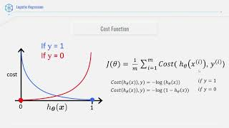
Logistic Regression cost function
Data-Driven Science on YouTube [link]
Notes:
With that understanding let’s look at the actual cost function used by LogisticRegression algorithm

Slide 11
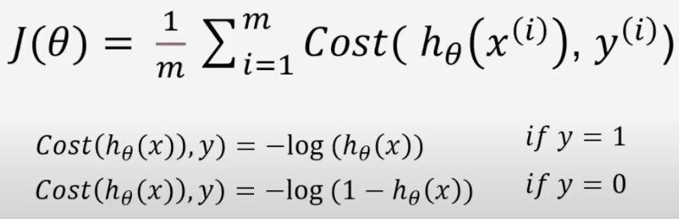
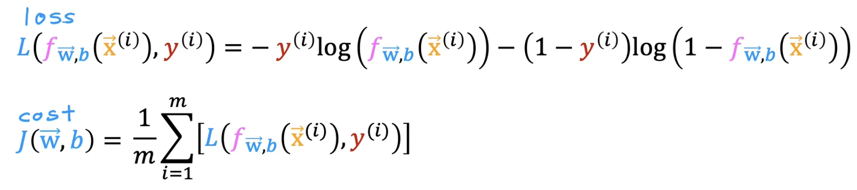
Simpler mathematical form of Cost Function
The two Cost equations can be combined to create a single equation
Log-loss: binary classification
Cross-Entropy loss: multi-class classification
Notes:
This is another representation of the LogisticRegression cost function that combines the two scenarios y = 1 and y = 0 in a single equation

Slide 12

Hands-on Exercises
Lesson 4 / Logit_Titanic.ipynb
https://github.com/techno-nerd/ML_101_Course/blob/main/04%20Classification/Logit_Titanic.ipynb
Notes:
For this lesson’s exercise, check out Logit_Titanic.ipynb. The model we will train here looks at predicting whether someone would survive the sinking of the Titanic or not.
The link to the repo can be found in the description below

Slide 13
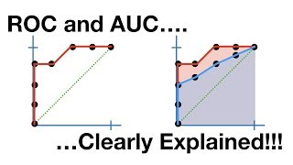

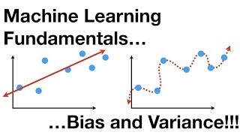
Further Reading / Watching / Doing
Logit_Titanic.ipynb
Logit_AnimalBinary.ipynb
StatQuest with Josh Starmer
Related to underfitting and overfitting topic
StatQuest with Josh Starmer
Notes:
To learn more, check out these videos about ROC, AUC, Bias and Variance. The hands-on exercise can be found in the repo linked in the description; it is about predicting whether someone would survive the sinking of the titanic or not.
To get more practise, check out the problem posed by the problem.md file, about classifying an animal as a mammal or not. To see my approach, look at Logit_AnimalBinary.ipynb.

Slide 14
Agenda for next class
Decision Trees
Introduction to Decision Tree
Classification Metrics
Confusion Matrix
Precision
Recall
Accuracy
Brief intro: KNN
Notes:
In the next lesson, we will go over another type of model that can be used for classification: Decision Trees.
We will also briefly touch on KNNs, which lie at the boundary between statistics and machine learning.

